Slide 1
Matrix Vector Multiply

Slide 2
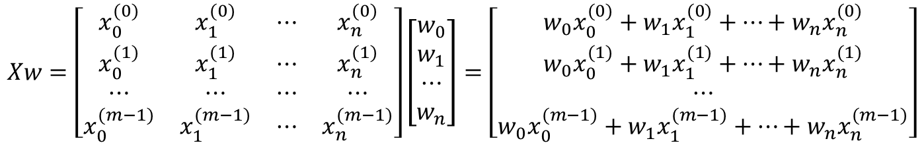
$$Xw=\left[\begin{matrix}x_{0}^{(0)} & x_{1}^{(0)} & ⋯ & x_{n}^{(0)} \\ x_{0}^{(1)} & x_{1}^{(1)} & ⋯ & x_{n}^{(1)} \\ ⋯ & ⋯ & ⋯ & ⋯ \\ x_{0}^{(m−1)} & x_{1}^{(m−1)} & ⋯ & x_{n}^{(m−1)}\end{matrix}\right]\left[\begin{matrix}w_{0} \\ w_{1} \\ ⋯ \\ w_{n}\end{matrix}\right]=\left[\begin{matrix}w_{0}x_{0}^{(0)}+w_{1}x_{1}^{(0)}+…+w_{n}x_{n}^{(0)} \\ w_{0}x_{0}^{(1)}+w_{1}x_{1}^{(1)}+…+w_{n}x_{n}^{(1)} \\ ⋯ \\ w_{0}x_{0}^{(m−1)}+w_{1}x_{1}^{(m−1)}+…+w_{n}x_{n}^{(m−1)}\end{matrix}\right]$$
2

Slide 3
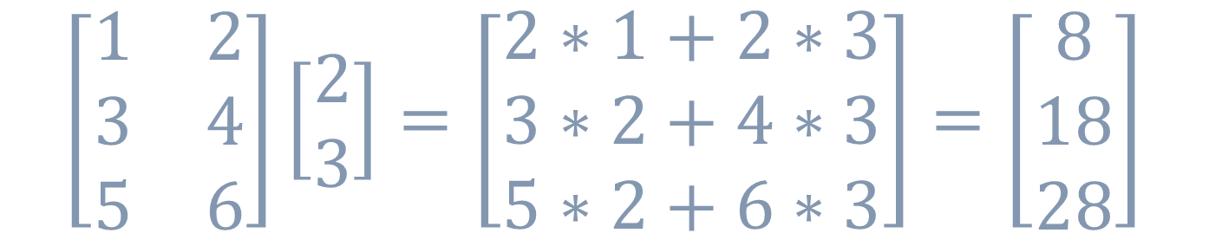
$$\left[\begin{matrix}1 & 2 \\ 3 & 4 \\ 5 & 6\end{matrix}\right]\left[\begin{matrix}2 \\ 3\end{matrix}\right]=\left[\begin{matrix}2∗1+2∗3 \\ 3∗2+4∗3 \\ 5∗2+6∗3\end{matrix}\right]=\left[\begin{matrix}8 \\ 18 \\ 28\end{matrix}\right]$$
2

Slide 4
Vectors

Slide 5
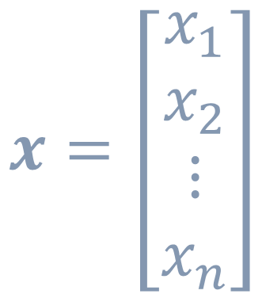
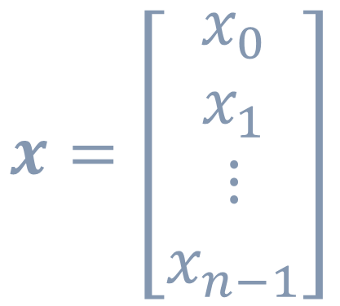
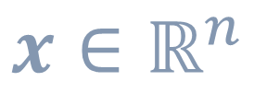
$$x=\left[\begin{matrix}x_{0} \\ x_{1} \\ ⋮ \\ x_{n−1}\end{matrix}\right]$$
$$x=\left[\begin{matrix}x_{1} \\ x_{2} \\ ⋮ \\ x_{n}\end{matrix}\right]$$
$$x∈ℝ^{n}$$
code
lecture

Slide 6
matrix multiply with vectors
Or Dot Product

Slide 7

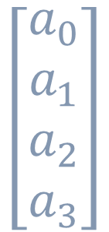

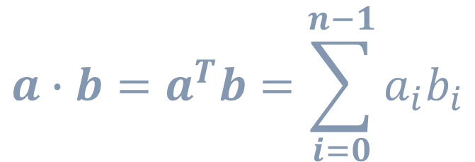
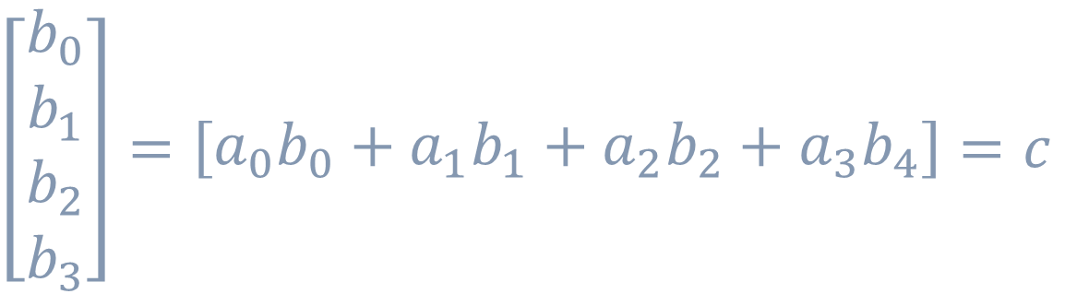


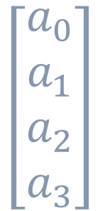
$${a∙b=a}^{T}b=\sum_{i=0}^{n−1}{a_{i}b_{i}}$$
$$\left[\begin{matrix}a_{0} \\ a_{1} \\ a_{2} \\ a_{3}\end{matrix}\right]$$
$\left[\begin{matrix}b_{0} \\ b_{1} \\ b_{2} \\ b_{3}\end{matrix}\right]=\left[\begin{matrix}a_{0}b_{0}+a_{1}b_{1}+a_{2}b_{2}+a_{3}b_{4}\end{matrix}\right]=c$
$$a∙b=$$
$$\left[\begin{matrix}a_{0} \\ a_{1} \\ a_{2} \\ a_{3}\end{matrix}\right]$$
$\left[\begin{matrix}b_{0} \\ b_{1} \\ b_{2} \\ b_{3}\end{matrix}\right]=\left[\begin{matrix}a_{0}b_{0}+a_{1}b_{1}+a_{2}b_{2}+a_{3}b_{4}\end{matrix}\right]=c$
$$a^{T}b=$$
$$\left[\begin{matrix}a_{0} & a_{1} & a_{2} & a_{3}\end{matrix}\right]$$
transform

Slide 8
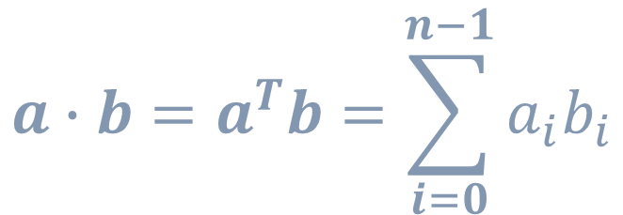
$${a∙b=a}^{T}b=\sum_{i=0}^{n−1}{a_{i}b_{i}}$$
$$\left[\begin{matrix}a_{0} \\ a_{1} \\ a_{2} \\ a_{3}\end{matrix}\right]$$
$\left[\begin{matrix}b_{0} \\ b_{1} \\ b_{2} \\ b_{3}\end{matrix}\right]=\left[\begin{matrix}a_{0}b_{0}+a_{1}b_{1}+a_{2}b_{2}+a_{3}b_{4}\end{matrix}\right]=c$
$$a∙b=$$
$\left[\begin{matrix}b_{0} \\ b_{1} \\ b_{2} \\ b_{3}\end{matrix}\right]=\left[\begin{matrix}a_{0}b_{0}+a_{1}b_{1}+a_{2}b_{2}+a_{3}b_{4}\end{matrix}\right]=c$
$$a^{T}b=$$
$$\left[\begin{matrix}a_{0} & a_{1} & a_{2} & a_{3}\end{matrix}\right]$$

Slide 9

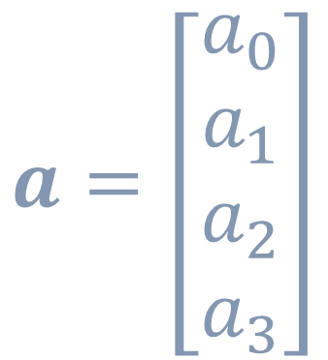
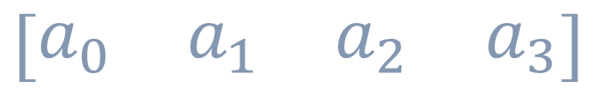
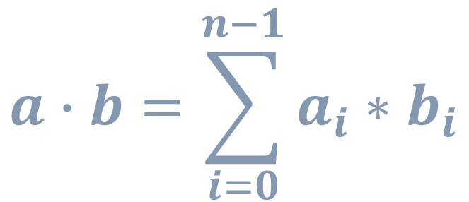
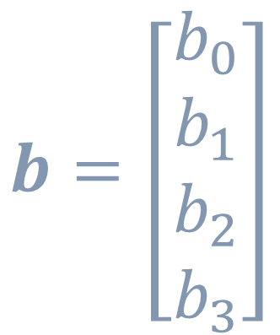
$$a=\left[\begin{matrix}a_{0} \\ a_{1} \\ a_{2} \\ a_{3}\end{matrix}\right]$$
$$b=\left[\begin{matrix}b_{0} \\ b_{1} \\ b_{2} \\ b_{3}\end{matrix}\right]$$
$$a,b∈ℝ^{4}$$
$$a∙b=\sum_{i=0}^{n−1}{a_{i}∗b_{i}}$$
$$\left[\begin{matrix}a_{0} & a_{1} & a_{2} & a_{3}\end{matrix}\right]$$

Slide 10
backup

Slide 11
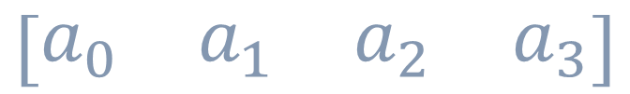
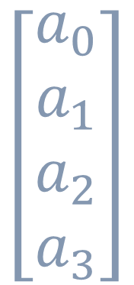
$$a=\left[\begin{matrix}a_{0} \\ a_{1} \\ a_{2} \\ a_{3}\end{matrix}\right]$$
$$b=\left[\begin{matrix}b_{0} \\ b_{1} \\ b_{2} \\ b_{3}\end{matrix}\right]$$
$$a,b∈ℝ^{4}$$
$$\left[\begin{matrix}a_{0} & a_{1} & a_{2} & a_{3}\end{matrix}\right]$$
$$a∙b=\sum_{i=0}^{n−1}{a_{i}∗b_{i}}$$
$$\left[\begin{matrix}a_{0} \\ a_{1} \\ a_{2} \\ a_{3}\end{matrix}\right]$$

Slide 12
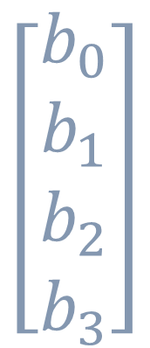

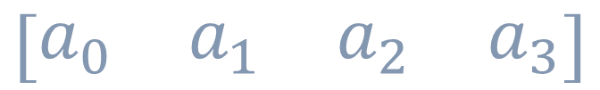
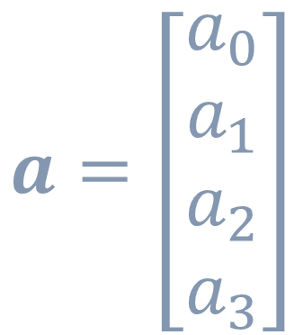
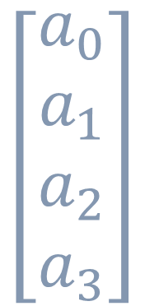
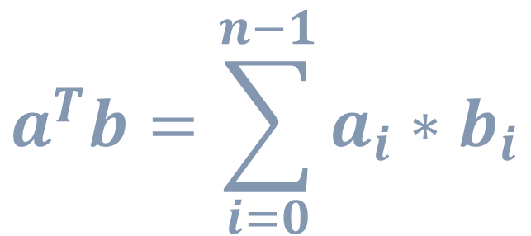
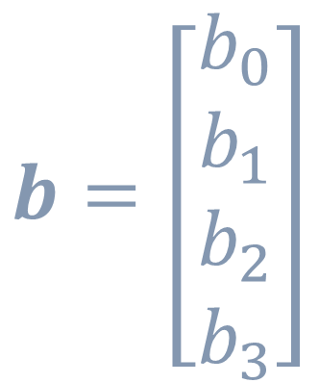
$$a=\left[\begin{matrix}a_{0} \\ a_{1} \\ a_{2} \\ a_{3}\end{matrix}\right]$$
$$b=\left[\begin{matrix}b_{0} \\ b_{1} \\ b_{2} \\ b_{3}\end{matrix}\right]$$
$$a,b∈ℝ^{4}$$
$$\left[\begin{matrix}a_{0} \\ a_{1} \\ a_{2} \\ a_{3}\end{matrix}\right]$$
$$\left[\begin{matrix}b_{0} \\ b_{1} \\ b_{2} \\ b_{3}\end{matrix}\right]$$
$$\left[\begin{matrix}a_{0} & a_{1} & a_{2} & a_{3}\end{matrix}\right]$$
$$a^{T}b=\sum_{i=0}^{n−1}{a_{i}∗b_{i}}$$

Slide 13
$$Xw=\left[\begin{matrix}x_{0}^{(0)} & x_{1}^{(0)} & ⋯ & x_{n}^{(0)} \\ x_{0}^{(1)} & x_{1}^{(1)} & ⋯ & x_{n}^{(1)} \\ ⋯ & ⋯ & ⋯ & ⋯ \\ x_{0}^{(m−1)} & x_{1}^{(m−1)} & ⋯ & x_{n}^{(m−1)}\end{matrix}\right]\left[\begin{matrix}w_{0} \\ w_{1} \\ ⋯ \\ w_{n}\end{matrix}\right]=\left[\begin{matrix}w_{0}x_{0}^{(0)}+w_{1}x_{1}^{(0)}+…+w_{n}x_{n}^{(0)} \\ w_{0}x_{0}^{(1)}+w_{1}x_{1}^{(1)}+…+w_{n}x_{n}^{(1)} \\ ⋯ \\ w_{0}x_{0}^{(m−1)}+w_{1}x_{1}^{(m−1)}+…+w_{n}x_{n}^{(m−1)}\end{matrix}\right]$$

Slide 14
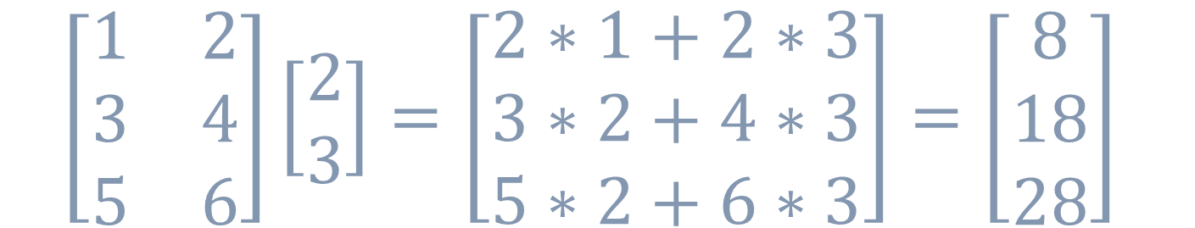
$$Xw=\left[\begin{matrix}x_{0}^{(0)} & x_{1}^{(0)} & ⋯ & x_{n}^{(0)} \\ x_{0}^{(1)} & x_{1}^{(1)} & ⋯ & x_{n}^{(1)} \\ ⋯ & ⋯ & ⋯ & ⋯ \\ x_{0}^{(m−1)} & x_{1}^{(m−1)} & ⋯ & x_{n}^{(m−1)}\end{matrix}\right]\left[\begin{matrix}w_{0} \\ w_{1} \\ ⋯ \\ w_{n}\end{matrix}\right]=\left[\begin{matrix}w_{0}x_{0}^{(0)}+w_{1}x_{1}^{(0)}+…+w_{n}x_{n}^{(0)} \\ w_{0}x_{0}^{(1)}+w_{1}x_{1}^{(1)}+…+w_{n}x_{n}^{(1)} \\ ⋯ \\ w_{0}x_{0}^{(m−1)}+w_{1}x_{1}^{(m−1)}+…+w_{n}x_{n}^{(m−1)}\end{matrix}\right]$$
$$\left[\begin{matrix}1 & 2 \\ 3 & 4 \\ 5 & 6\end{matrix}\right]\left[\begin{matrix}2 \\ 3\end{matrix}\right]=\left[\begin{matrix}2∗1+2∗3 \\ 3∗2+4∗3 \\ 5∗2+6∗3\end{matrix}\right]=\left[\begin{matrix}8 \\ 18 \\ 28\end{matrix}\right]$$
2

Slide 15
$$Xw=\left[\begin{matrix}x_{0}^{(0)} & x_{1}^{(0)} & ⋯ & x_{n}^{(0)} \\ x_{0}^{(1)} & x_{1}^{(1)} & ⋯ & x_{n}^{(1)} \\ ⋯ & ⋯ & ⋯ & ⋯ \\ x_{0}^{(m−1)} & x_{1}^{(m−1)} & ⋯ & x_{n}^{(m−1)}\end{matrix}\right]\left[\begin{matrix}w_{0} \\ w_{1} \\ ⋯ \\ w_{n}\end{matrix}\right]=\left[\begin{matrix}w_{0}x_{0}^{(0)}+w_{1}x_{1}^{(0)}+…+w_{n}x_{n}^{(0)} \\ w_{0}x_{0}^{(1)}+w_{1}x_{1}^{(1)}+…+w_{n}x_{n}^{(1)} \\ ⋯ \\ w_{0}x_{0}^{(m−1)}+w_{1}x_{1}^{(m−1)}+…+w_{n}x_{n}^{(m−1)}\end{matrix}\right]$$
$$\left[\begin{matrix}1 & 2 \\ 3 & 4 \\ 5 & 6\end{matrix}\right]\left[\begin{matrix}2 \\ 3\end{matrix}\right]=\left[\begin{matrix}2∗1+2∗3 \\ 3∗2+4∗3 \\ 5∗2+6∗3\end{matrix}\right]=\left[\begin{matrix}8 \\ 18 \\ 28\end{matrix}\right]$$
2

